Slide 1

Automated Book Circulation and Library Record System
Using MySQL
Name : V. Srenitha
Batch : 436

Slide 2
About
I am a B. Tech graduate in Computer Science Engineering from University college of Engineering and Technology for Women
Learning Data Science will prepare me for the future. we live in a data-driven world, where data-driven decisions are essential in technology, business, and research.
Working Experience : Fresher
LinkedIn : https://www.linkedin.com/in/vakul-srenitha-2b0736372/
GitHub : https://github.com/Srenitha07

Slide 3
Agenda
BUSINESS PROBLEM STATEMENT
OBJECTIVE OF THE PROJECT
TABLES
DATA MODEL-(EER DIAGRAM)
KEY ANALYSIS QUESTION
SQL QUERIES & RESULTS
FINAL BUSINESS INSIGHTS
CONCLUSION
Q & A
EXPERIENCE/CHALLENGES WORKING ON SQL

Slide 4

BUSINESS PROBLEM STATEMENT
Many libraries still use registers or Excel, so issuing and returning books is slow, confusing, and full of mistakes.
Librarians and students face problems checking book availability, due dates, and fine calculation, especially during exam time.
A MySQL-based Library Management System puts everything in one place, automates daily work, saves time, reduces errors, and makes the library system smooth and organized.

Slide 5
OBJECTIVE OF THE PROJECT
The objective of this Library Management System is to streamline library operations by automating key functions such as book tracking, user management, and transaction processing. Using MySQL, the system will efficiently manage book details, member information, and overdue items. It aims to enhance the user experience with advanced search capabilities and generate useful reports for library staff. Overall, this project seeks to create a simple, effective, and scalable solution for modern library management.

Slide 6
TABLES
Created tables are:
tbl_books
tbl_authors
tbl_book_copies
tbl_book_loans
tbl_borrower
tbl_library_branch
tbl_publisher

Slide 7
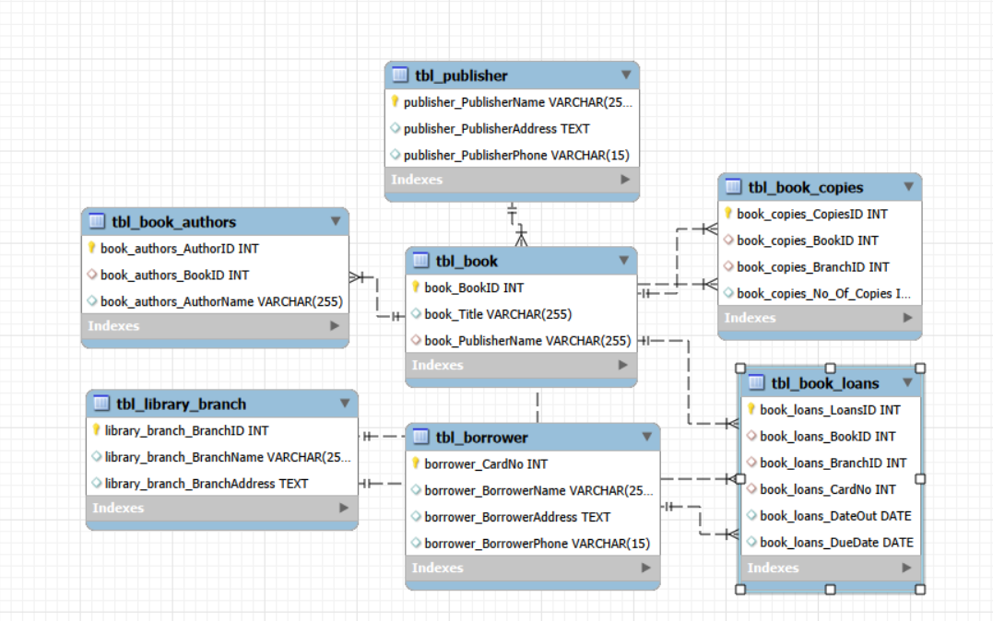
Data Model(EER DIAGRAM)

Slide 8
KEY ANALYSIS QUESTION
Which borrowers have never borrowed any books from the library?
How many copies of the book titled "The Lost Tribe" are owned by each library branch?
Retrieve the names, addresses, and number of books checked out for all borrowers who have more than five books checked out.
How many copies of the book titled "The Lost Tribe" are owned by the library branch whose name is "Sharpstown"?
For each book that is loaned out from the "Sharpstown" branch and whose Due Date is 2/3/18, retrieve the book title, the borrower's name, and the borrower's address.
For each book authored by "Stephen King", retrieve the title and the number of copies owned by the library branch whose name is "Central".

Slide 9
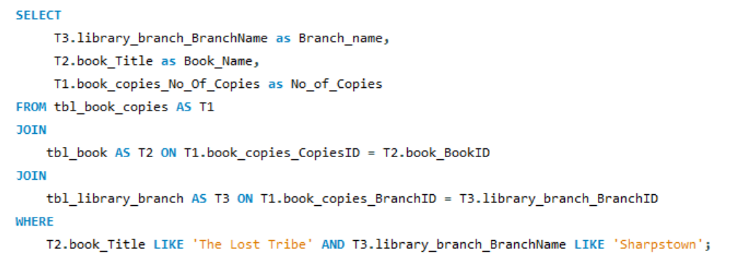

SQL QUERY & RESULTS
1. How many copies of the book titled "The Lost Tribe" are owned by the library branch whose name is "Sharpstown"?

Slide 10
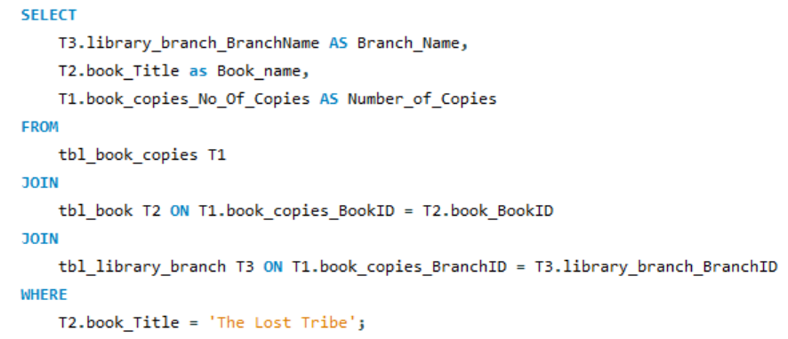
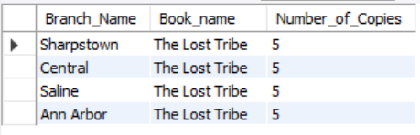
SQL QUERY & RESULTS
2. How many copies of the book titled "The Lost Tribe" are owned by each library branch?

Slide 11
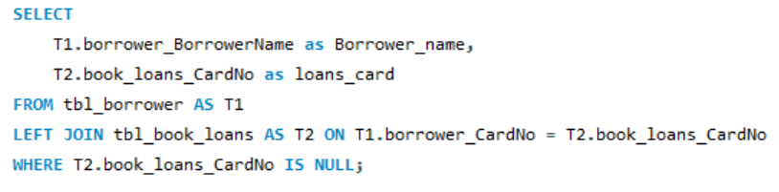

SQL QUERY & RESULTS
3. Retrieve the names of all borrowers who do not have any books checked out.

Slide 12
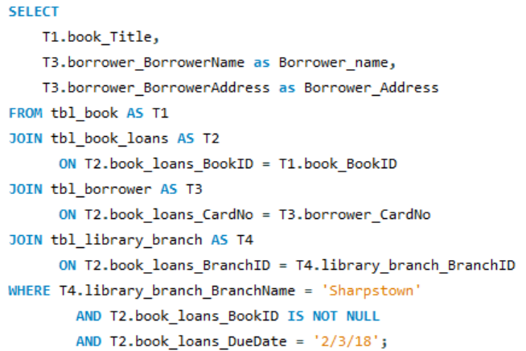
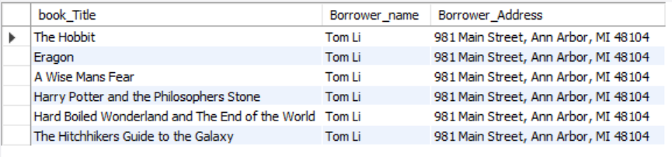
SQL QUERY & RESULTS
4. For each book that is loaned out from the "Sharpstown" branch and whose Due Date is 2/3/18, retrieve the book title, the borrower's name, and the borrower's address.

Slide 13

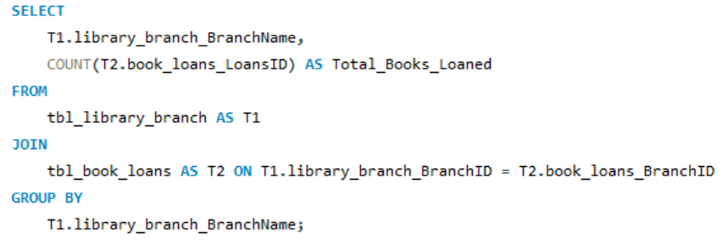
SQL QUERY & RESULTS
5. For each library branch, retrieve the branch name and the total number of books loaned out from that branch.

Slide 14
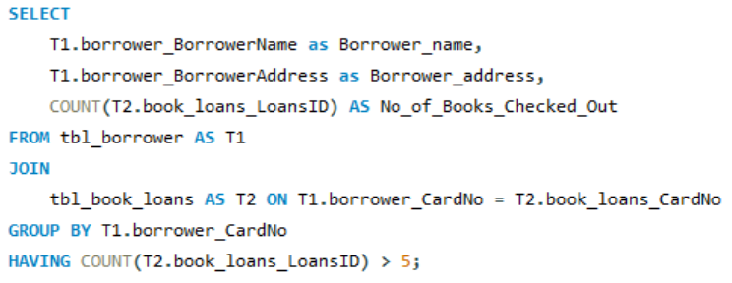

SQL QUERY & RESULTS
6. Retrieve the names, addresses, and number of books checked out for all borrowers who have more than five books checked out.

Slide 15
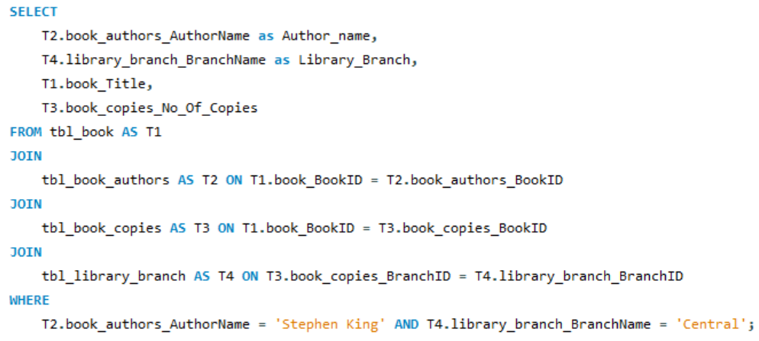

SQL QUERY & RESULTS
7. For each book authored by "Stephen King", retrieve the title and the number of copies owned by the library branch whose name is "Central".

Slide 16
Final Business Insights
Enabled data-driven decision-making by providing clear insights into book demand, branch-wise usage, and borrower activity.
Reduced manual effort and operational errors through automated tracking of book issues, returns, and due dates.
Improved resource utilization by identifying high-usage and inactive borrowers, supporting fair and efficient library policies.
Delivered a scalable and reliable system that enhances overall library efficiency and user experience.

Slide 17
CONCLUSION
In conclusion, the Library Management System built with MySQL provides an effective, automated solution to the challenges faced by modern libraries. By enhancing the management of books, users, and transactions, the system improves overall efficiency, reduces manual errors, and offers a better experience for both library staff and users. The use of MySQL ensures a robust, scalable database that can grow with the library’s needs. This project demonstrates how technology can optimize traditional systems, making library management more streamlined, accessible, and user-friendly.

Slide 18


Slide 19
Experience/Challenges working on SQL
Faced challenges in designing proper tables and relationships, which helped me understand database structure and normalization better.
Writing queries with joins was challenging initially, but it improved my SQL and logical thinking skills.
Gained hands-on experience with CRUD operations and managing real-world data like books, borrowers, and loans.

Slide 20

THANK YOU

